Slide 1
Adv. Web Application Development
ASP.net
Fabio Alexandre Ciconi

Slide 2
Summary
Web Services and Cloud Services
Big Data and Data Concept
Which one is safer to use in connecting to SQL Server
Asymmetric key x Symmetric key
Storyboards
Paper Prototype

Slide 3
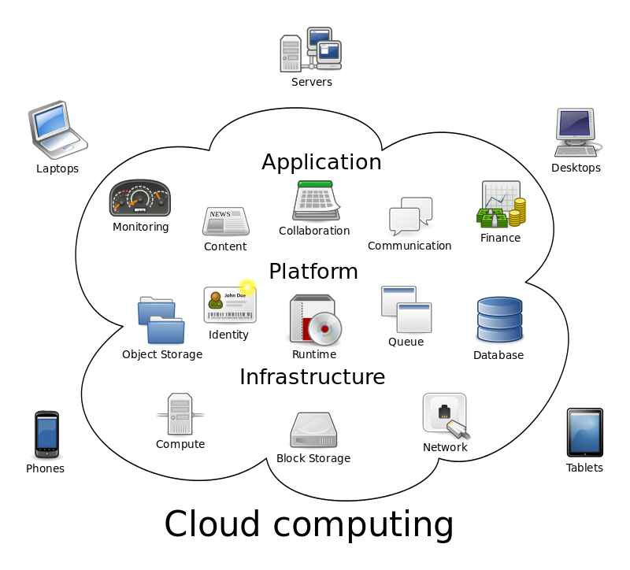
Web Services X Cloud Services
Web Services: are the tools that allow users to interact with software over the Internet.
Cloud Services: are the servers that store the data, security and other infrastructure pieces needed to allow Web services to provide unique value as Web-accessible applications.

Slide 4
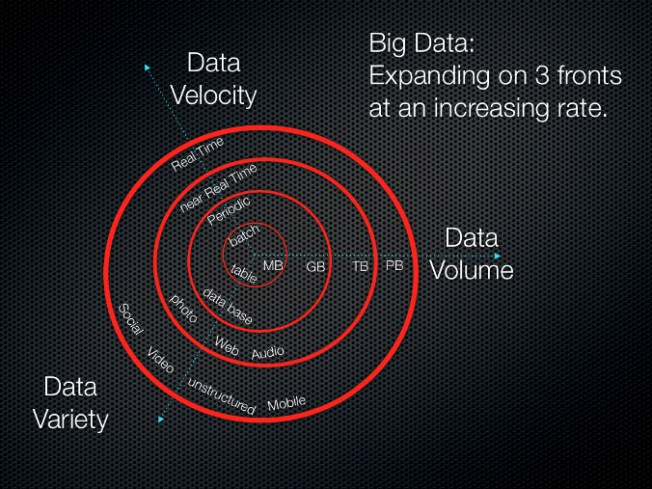
Main differences between Big Data and Data concept
The term Big Data, especially when used by vendors, may refer to the technology (which includes tools and processes) that an organization requires to handle the large amounts of data and storage facilities.

Slide 5
Which one is safer to use in connecting to SQL Server
According to Microsoft, the SQL authentication is not safer than windows authentication, because in the SQL authentication you have for various database systems only a username and a password. When a user connects through a Windows user account, SQL Server validates the account name and password using the Windows principal token in the operating system. This means that the user identity is confirmed by Windows.
Microsoft’s best practice recommendation is to use Windows authentication.

Slide 6
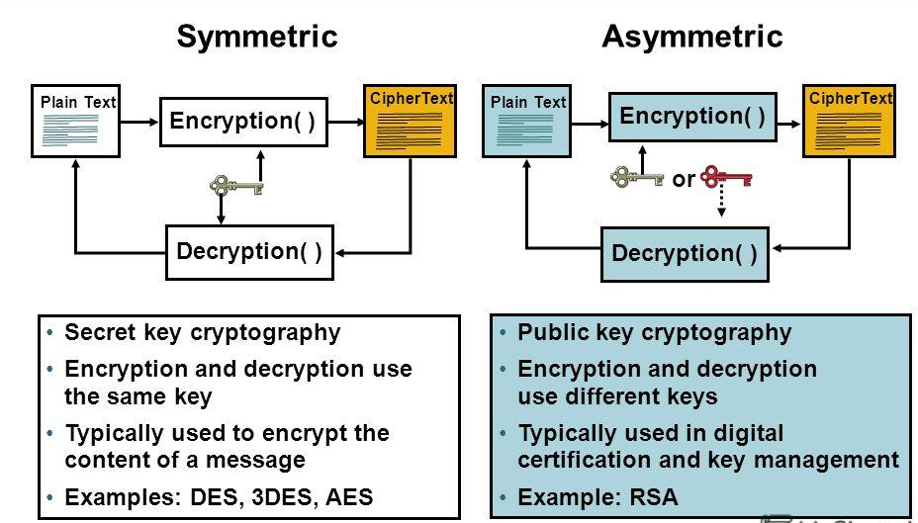
Please explain which one uses asymmetric key and which one uses symmetric key?
Symmetric encryption is a type of encryption where the same key is used to encrypt and decrypt the message. This differs from asymmetric (or public-key) encryption, which uses one key to encrypt a message and another to decrypt the message.
Asymmetric encryption, in which there are two related keys--a key pair. A public key is made freely available to anyone who might want to send you a message. A second, private key is kept secret, so that only you know it.

Slide 7
Search about Storyboards and briefly explain about it.
Storyboarding can provides:
a visual look at the layout of the site,
type of organization you need to use,
first look at navigational system.
Online tool: Flairbuilder.com

Slide 8
Search about Paper Prototype and briefly explain about it.
Paper prototyping is a widely used method in the user-centered design process, a process that helps developers to create software that meets the user's expectations and needs—in this case, especially for designing and testing user interfaces.
Online tools: Bootstrap or Foundation

